Slide 1

Online Insurance Application
Team: Sumit Singh, Shouryan Sood, Samrat Rode, Shruti Sanjana

Slide 2

Outline
Problem Statement
Objective
Microservices
Project Overview
Onboarding-Architecture
Project Flow
Technology and Tools Used
Conclusion

Slide 3

Problem Statement
Insurance industry grappling with outdated processes in the face of increasing digital reliance.

Slide 4

Objective
Create a user-friendly full-stack web application facilitating seamless insurance policy selection and purchase.

Slide 5

Microservice Architecture
Registry
Appgateway
User auth
Dashboard service
Database s
Cart service
Feedback
Discount s

Slide 6
Project Overview

Slide 7
Project Overview
Dashboard API
Internal API
Internal API
Cart Service
Login
Purchase Service
User
Register
Policy Service
My SQL
My SQL
Public API

Slide 8
Onboarding Architecture

Slide 9
Architecture
User
Authentication API
User
Login/Register
POST/GET
Database Service
Get/Policy Policy
Delete Policy
POST /GET/
DELETE
GET/DELETE
Policy
Policy Owned
REACT
GET/
POST
Cart Service API
Insurance
GET/POST
Dashboard Service
Internal API
GET/
POST
GET/POST/PUT

Slide 10
Project Flow

Slide 11
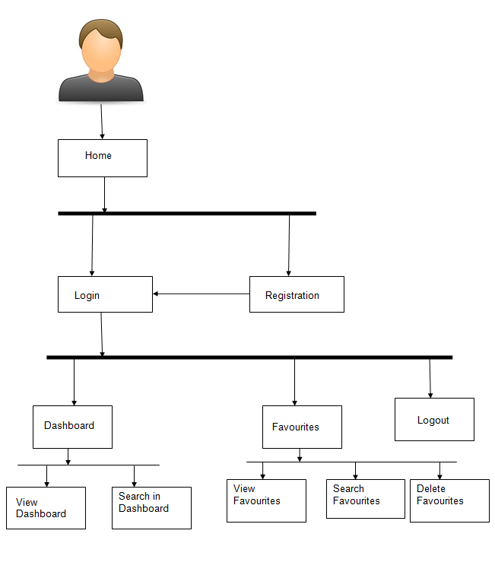
Project Flow
Home
Login
Register
Policy
Add to Cart
Cart
Recommends
Purchase
View
Cart Items
Delete
Cart Items
Policies In Cart
View Purchased Policies
Search Books

Slide 12
Project Snippets

Slide 20








Technologies and Tools Used

Slide 21
Conclusion
Digital Transformation: Our Online Insurance Application signifies a step in digitizing and transforming the insurance sector.
Efficiency Upgrade: By addressing outdated offline/online processes, we pave the way for a more efficient experience.
Innovation for Accessibility: Embracing innovation, we aim to make insurance more accessible and personalized for every user.
Industry Reshaping: Our proposal sets the stage for reshaping industry standards towards a more agile and responsive insurance ecosystem.
Expanded Reach: By offering a digital platform, insurance companies can extend their reach to a broader audience, tapping into previously untapped markets.

Slide 22
Future Scope
AI Integration:
Explore integrating AI for precise risk assessment and personalized policy recommendations.
Continuous Feedback Analytics:
Utilize advanced analytics for actionable insights from user and company feedback.
Cybersecurity Advancements:
Stay updated on cybersecurity advancements to safeguard user information.
Regulatory Compliance Upgradation:
Proactively update the platform to comply with evolving regulations and industry standards

Slide 23
Thank You

Slide 24


